Slide 1
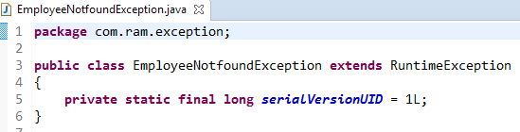
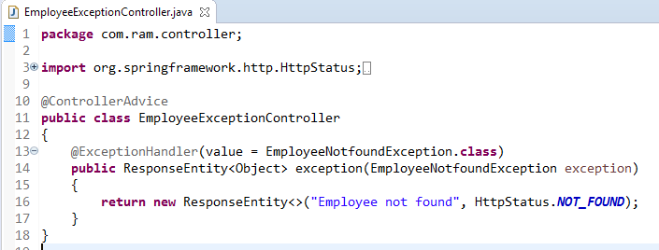
Spring Boot - Exception Handling
The @ControllerAdvice is an annotation, to handle the exceptions globally.
The @ExceptionHandler is an annotation used to handle the specific exceptions and sending the custom responses to the client.

Slide 2
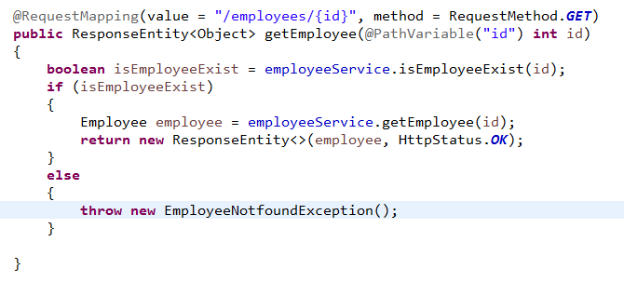
Spring Boot - Exception Handling
We used the GET API to get the Employee. Here, while getting the Employee, if the Employee is not found, then return the response error message as “Employee not found”. Note that the
EmployeeNotFoundException exception class should extend the RuntimeException.

Slide 3
Spring Boot - Exception Handling
https://www.udemy.com/course/restful-web-services-with-spring-framework-a-quick-start/learn/lecture/12105502#overview

